Slide 1
A MULTI-SOURCE VIDEO GAME POPULARITY ANALYSIS USING STEAM PLAYER DATA AND GOOGLE TRENDS
by
Std Name: TAIMOOR AHMAD
Std Number: 20054191
Submitted To: PAUL LARID

Slide 2
PROJECT OBJECTIVES
To analyze video game popularity
To transform raw gaming data into meaningful insights using feature engineering techniques.

Slide 3
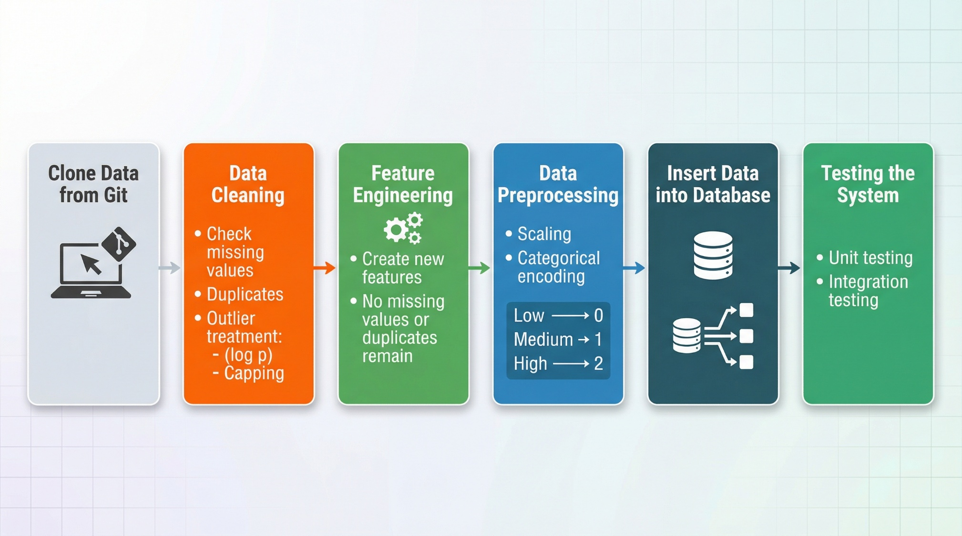
ARCHITECTURE OF THE PROJECT
Declaration: https://chatgpt.com/share/69d8abd1-0b6c-832f-b3b3-5c229df19805

Slide 4
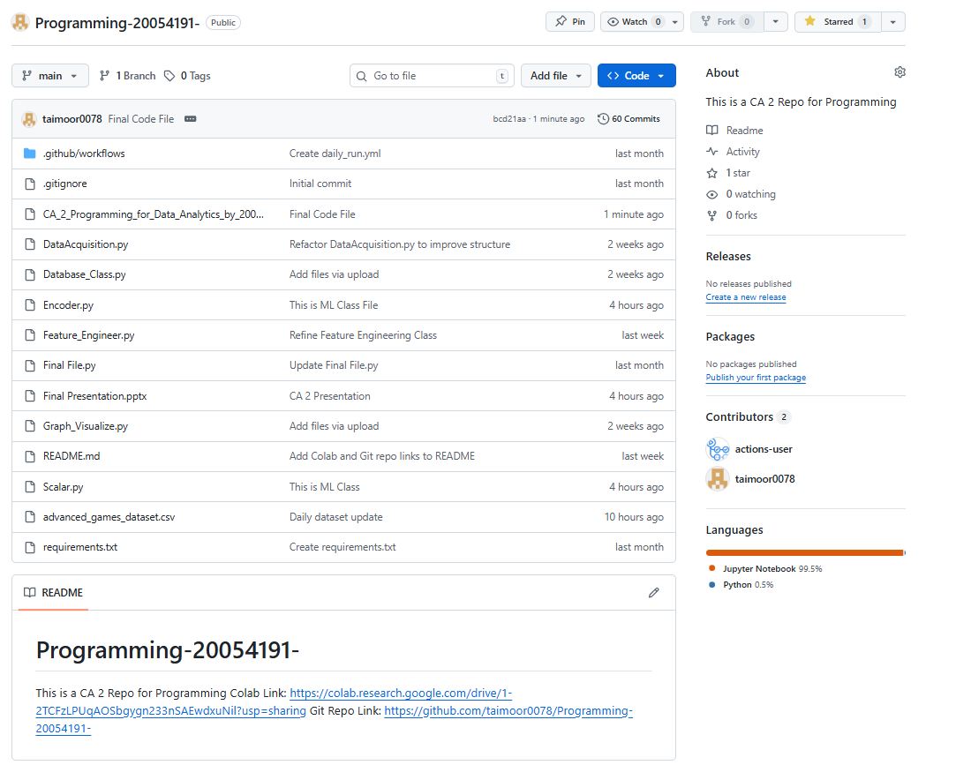
GIT PUBLIC REPOSITORY
Link of the Repository
https://github.com/taimoor0078/Programming-20054191-
Overview of the Repository

Slide 5
DATA ACQUISITION
Sources of the data
Steam Api
https://store.steampowered.com/api/appdetails?appids=%7Bappid%7D&cc=us
Steam Charts
https://steamcharts.com/
Google Trends
How did data acquire?
Access public Api of steam store and access data of multiple games using games id
name, appid, price, discount, initial_price, total_reviews, positive_reviews, negative_reviews, is_free
Scrape data from Steam charts using BeautifulSoap
avg_players, peak_players
Access trends of google using pytrend
interest_over_time()
Ethical Consideration of data
Public Data availability
No sensitive data involve

Slide 6
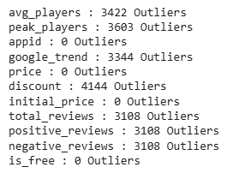
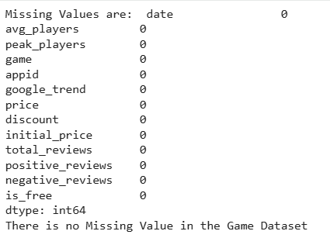

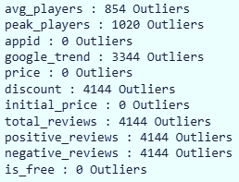
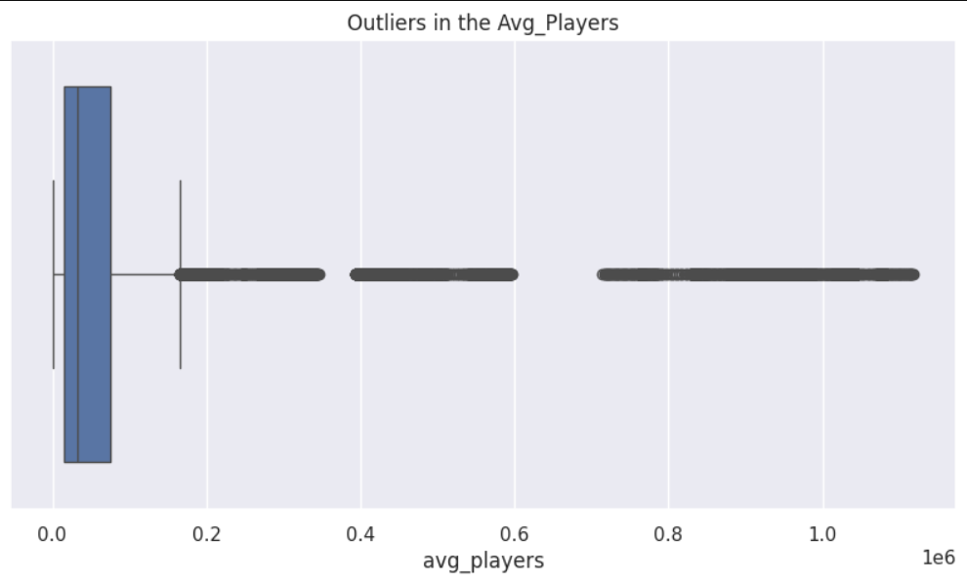
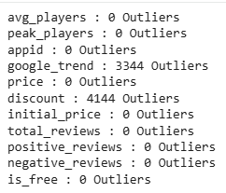
DATA CLEANING
Checking Missing Values
No Missing Values in the Games Dataset
Checking Duplicates
No Duplicates were found in the Games Dataset
Checking and Transforming Outliers
Multiple Outliers found in the Games Dataset.
All Outliers were Right Skewed.
Instead of Deletion. Apply Log Transformation and Capping.

Slide 7
FEATURE ENGINEERING
Popularity Score
.5 * (Avg_Players) + .3 * (Google_Trends) + .2 * Total_Reviews
Popularity Level
Low = Popularity Score <= 33
Medium = 33 < Popularity Score <= 66
High = Popularity Score > 66
Best Game Over Time
True if Avg Player > 80 Percentile
Need Discount
True if : Discount = 0 AND Player Growth (% in change in Player Growth) < 0
Engagement Ratio
Peak Players/Avg Players
Community Sentiments
Positive Reviews / (Positive + Negative Reviews)
Player Momentum
7-Days Moving Players - 30 Days Moving Players

Slide 8
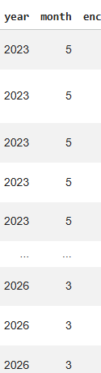
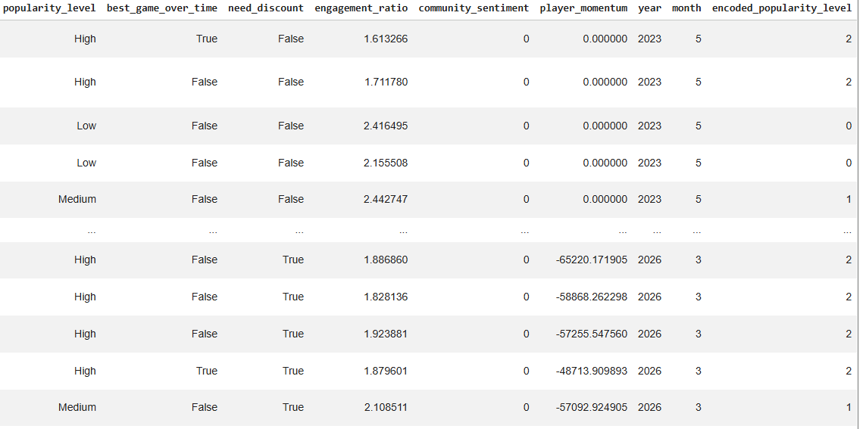
DATA PREPROCESSING
Converted date
Month: final_Dataset['date'].dt.month
Year: final_Dataset['date'].dt.year
Encoded Popularity Level
Using cat.codes because it is a categorical variable low, medium and high that gave wrong value using Label encoding.

Slide 9
CONTI.
Applied cat codes to Bool variables
Dropped some numeric columns because there were no need to scale them
Applied Standard Scaling to remaining numeric columns
Dropped unnecessary columns

Slide 10
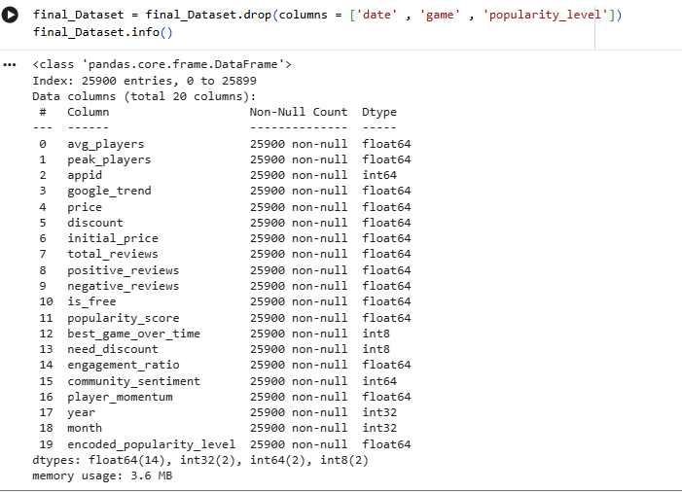
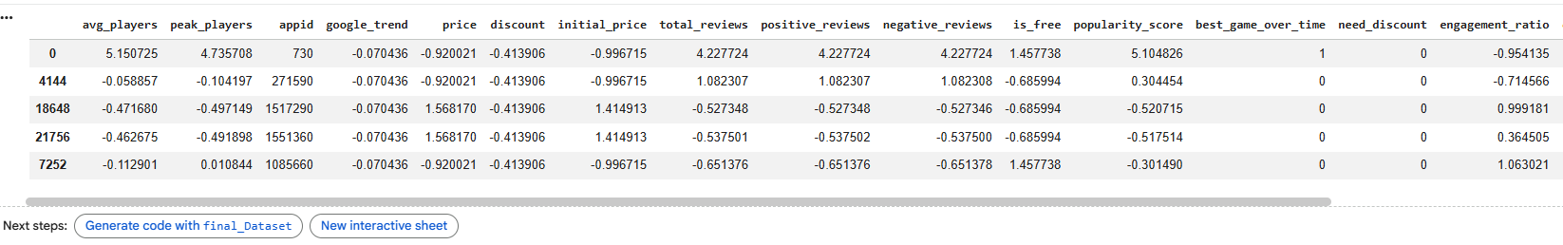
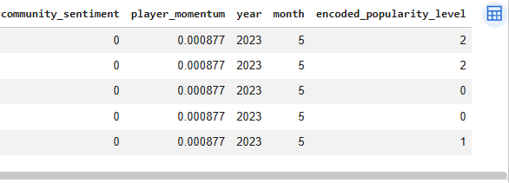
FINAL LOOK OF DATASET

Slide 11
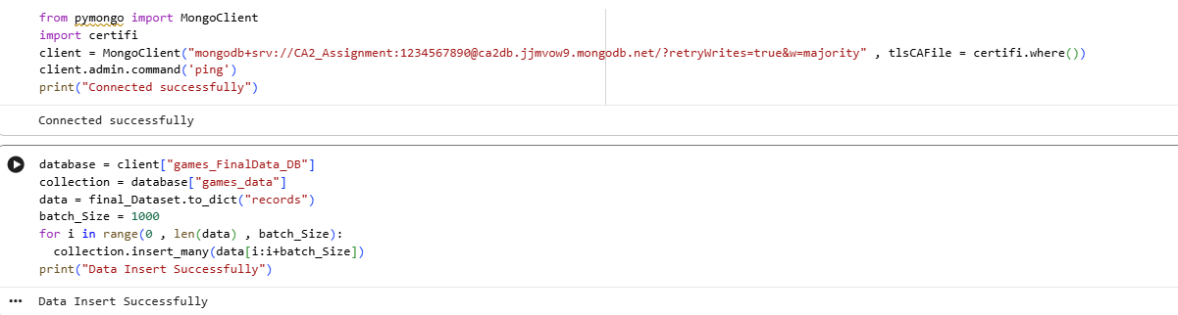
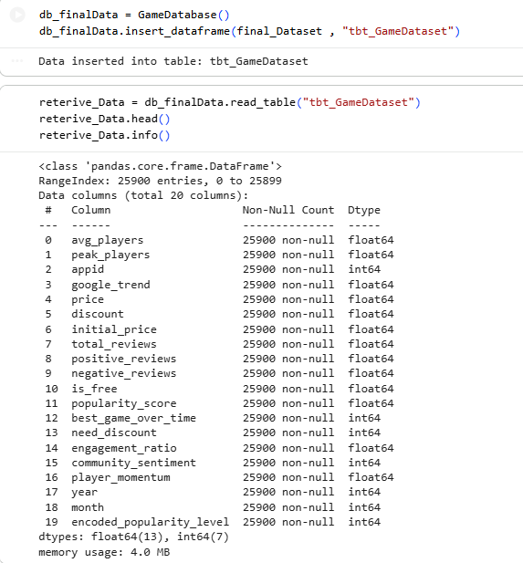
DATABASE
Mongo DB
SQLite
Why use Hybrid Database
Implemented both NoSQL and relational storage for flexibility and structured querying

Slide 12
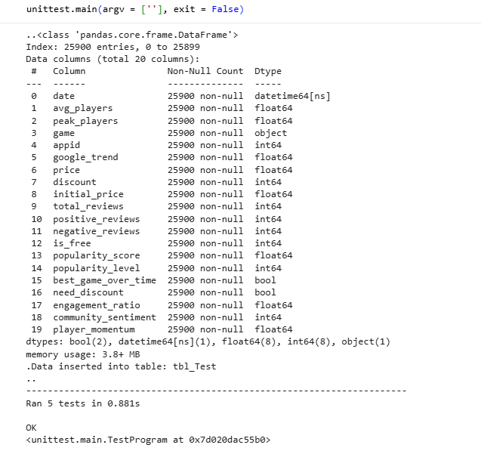
TESTING OF THE SYSTEM
Unit Testing
test_feature_engineering(self)
test_encoding(self)
test_scaling(self)
Integration Testing
test_full_pipeline(self)
test_full_pipeline_noerror(self)

Slide 13
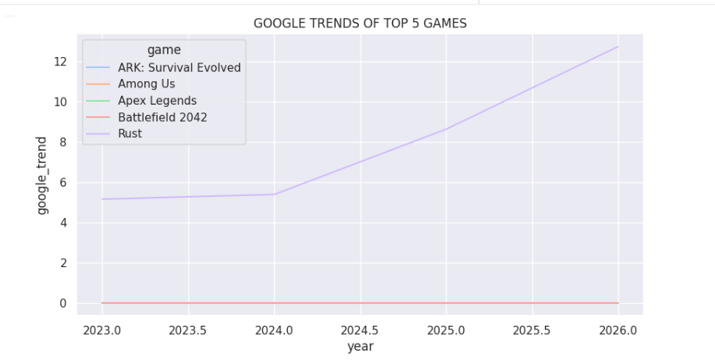
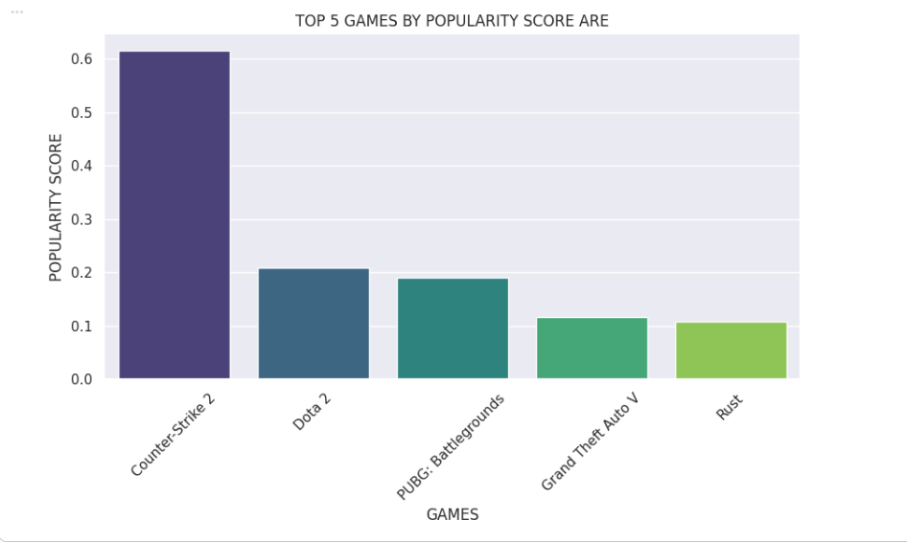
DATA INSIGHTS

Slide 14
COMPLEXITY OF THE PROJECT
Collecting data from multiple resources
Custom feature engineering including a weighted popularity score
Full preprocessing pipeline with cat codes and scaling
Hybrid database design using MongoDB and SQLite

Slide 15
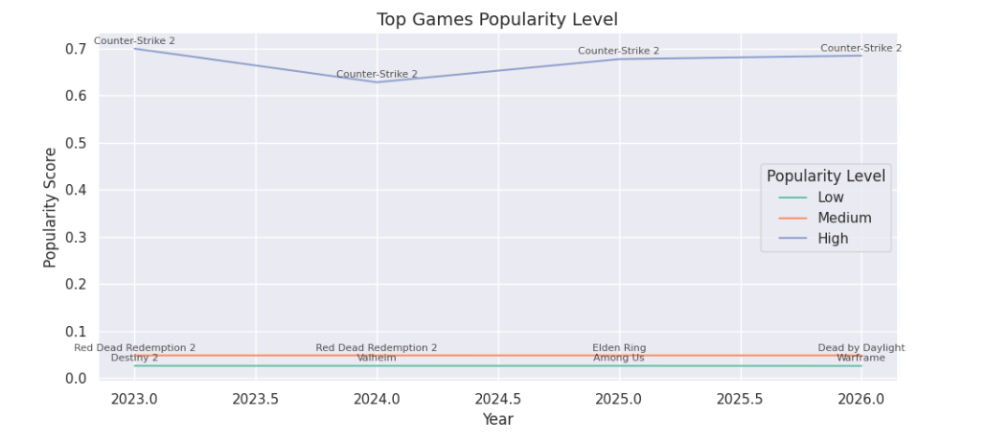
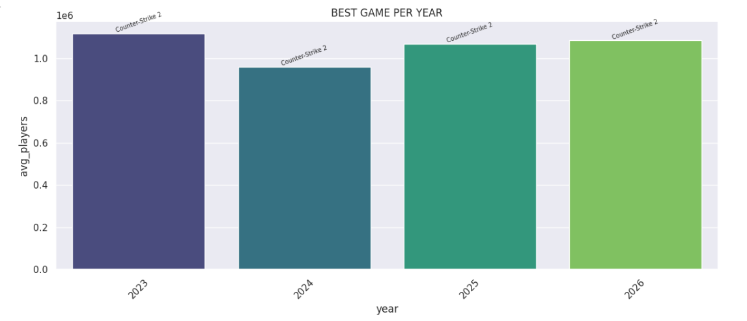
CONTI.

Slide 16
THANK YOU!

